Slide 1
Silent Authentication
Trusted, seamless, and personalized authentication

Slide 2

Why
To have a painless , secure authentication with ease of use and improved data privacy.
Notes:
Tell us what the goal, value and/or benefit is

Slide 3

What
With silent authentication below problems are being solved:
Customer doesn’t share PII out loud.
Identity Verification which is prone to Data breach.

Slide 4

Who
Silent Authentication makes authentication easy for anyone who is trying to call Discover customer support center for a specific use case. Below are some examples
Discover Bank account holder
Discover Credit card user

Slide 5
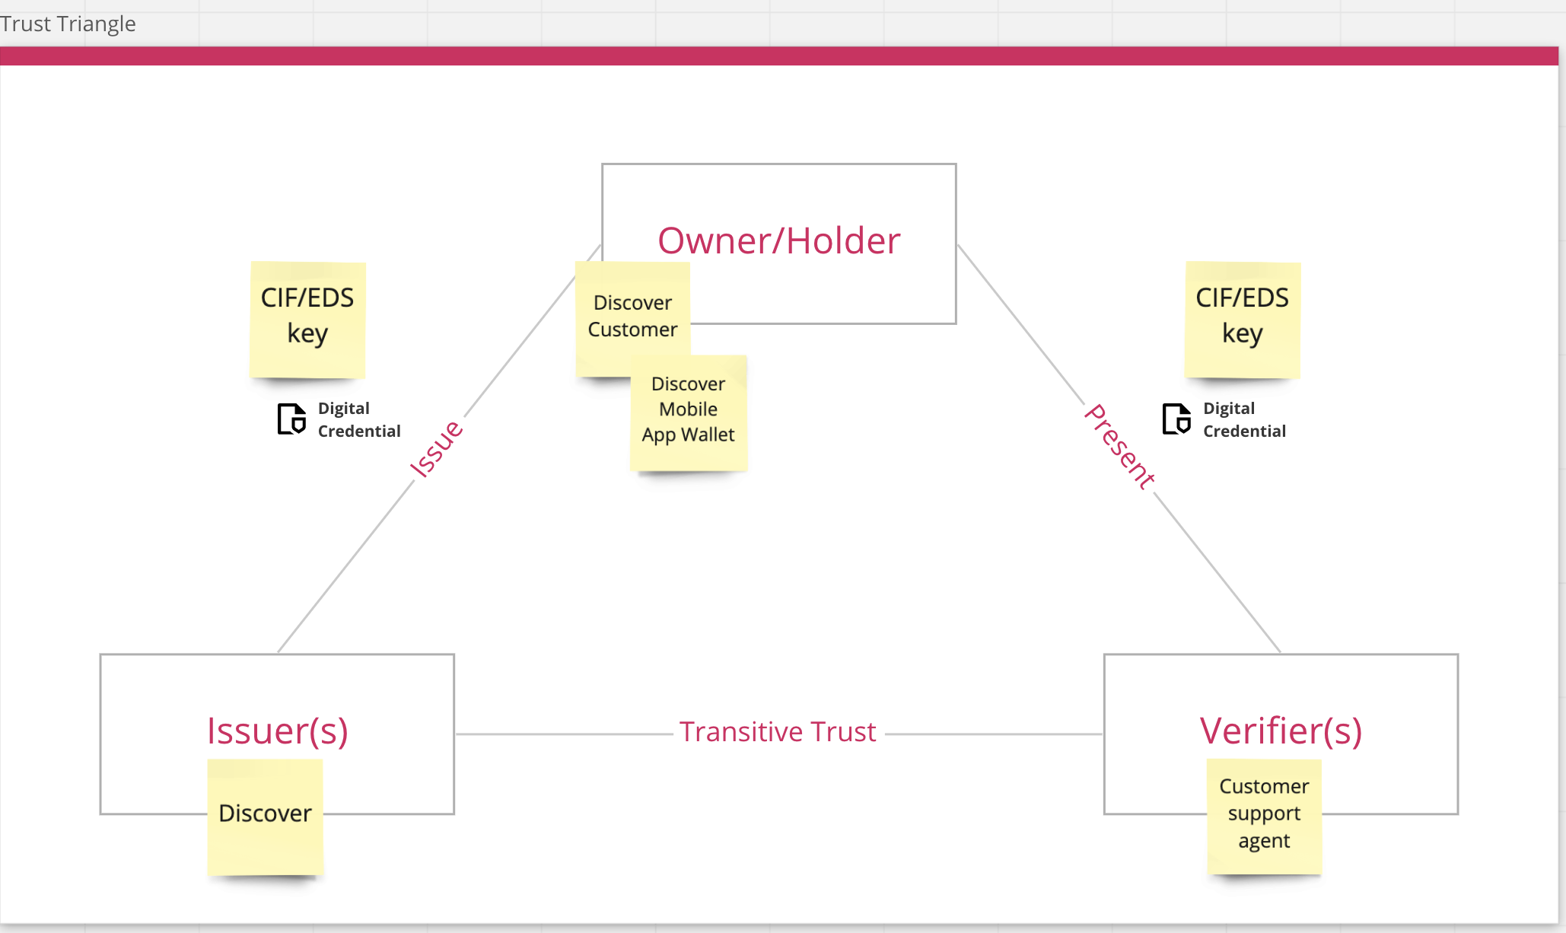

Slide 6
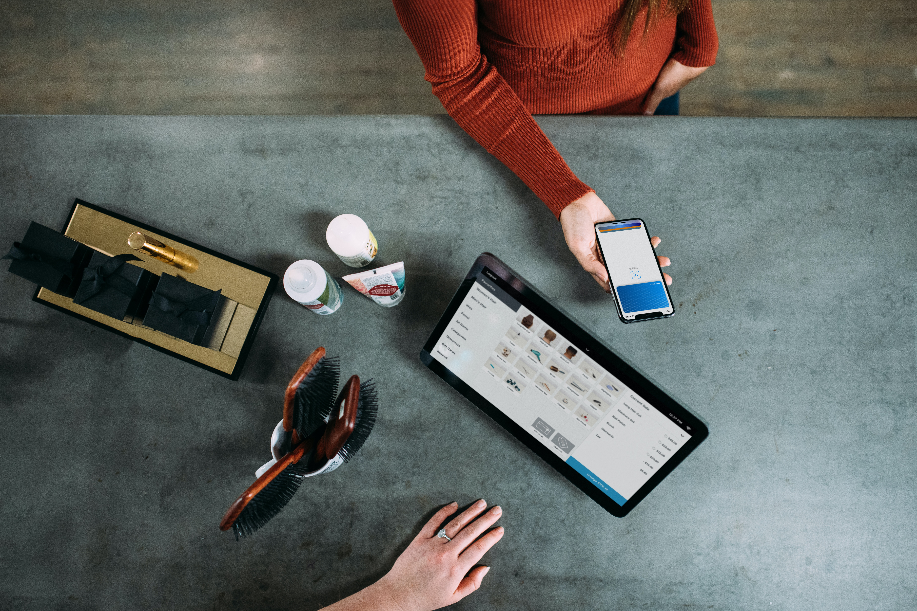
Where
There are many scenarios where user doesn’t want to share his Personal Identification Information and needs to be authentication silently like :
Coffee shop
Travelling
Any public/non secure setting

Slide 7
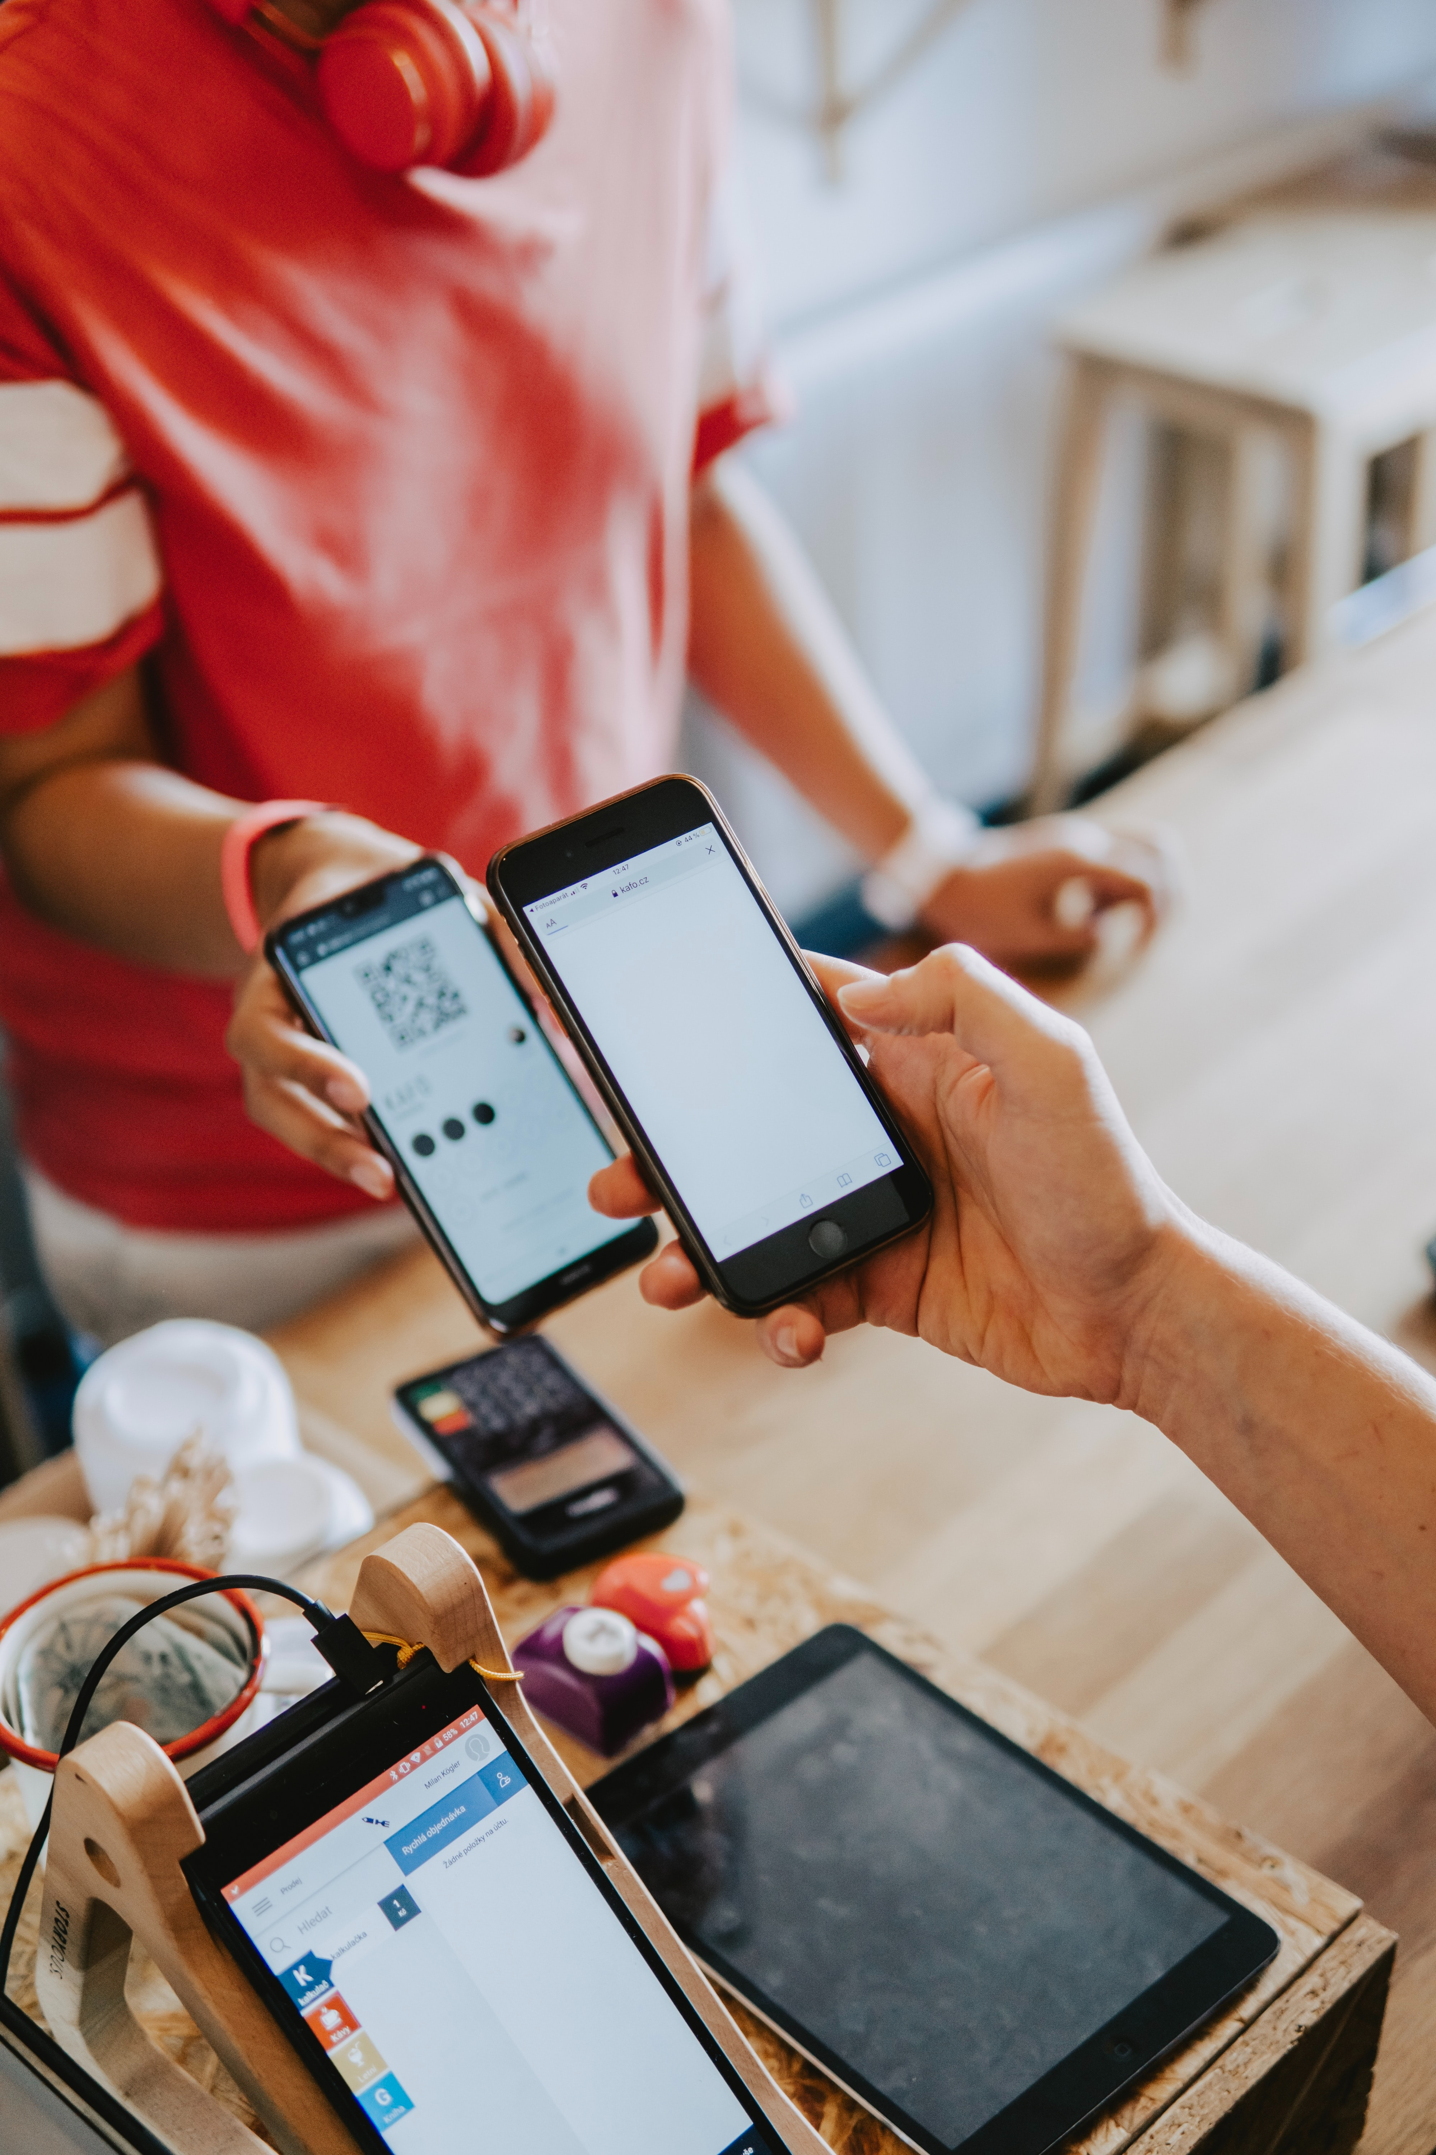
When
This can happen in any public setting. This happens all the time.

Slide 8

Wow
Tell us how this will benefit Discover and the trust triangle stakeholders
Who | Wow Factor
Issuer | A digitally trusted marketplace with reduced fraud and less man hours.
Holder | Not required to share any PII on call with customer support agent. Need not worry about stolen identity or sensitive data exposure. A trusted environment set up!
Verifier | No manual verification of PII like Date of Birth, last four of SSN, mothers maiden name, address etc. An average of 270k bank users both mobile and web call customer service every day. Silent authentication eliminates the whole manual process.
Discover | Improved fraud prevention and faster, secured and trusted authentication. 100 % Customer satisfaction and security.

